Slide 1
Targeted Service RLI - Part 2
Notes:
Begin the session:
Introduce self
Describe format for the session
Talk about what materials are available and/or where they can be found

Slide 2
Goals:
Review
Review the Rotary Foundation Funding Model
Discuss
Discuss the Importance of the Rotary Foundation Funding Model to your Club
Explore
Explore the Seven Areas of Focus and their relationship with projects funded by Rotary Foundation
Understand
Understand the Concept of Sustainability as it relates to Grant Funding
Notes:
Review Session Goals, where this course fits into the Service curriculum of RLI
Quickly review Insert: TS-1 “Good to Know for Targeted Service”

Slide 3

Mission of The Rotary Foundation (TRF)
…is to enable Rotarians to advance world understanding, goodwill and peace through the improvement of health, the support of education and the alleviation of poverty.
Notes:
Introduce the Mission of THE ROTARY FOUNDATION:
Looking at the mission of TRF think of an example of something your club has done that supports this mission. Raise your VIRTUAL HAND and unmute to offer your thoughts.
Take one or two examples.

Slide 4

The Why and What of The Rotary Foundation
Not-for-Profit Organization
Supported by Voluntary Contributions
Donors Share a Vision for a Better World
Makes Possible Projects that bring Sustainable Improvement to Communities
www.charitynavigator.com
Notes:
Share with the participants what the Rotary Foundation is and why it was formed.
Include in the discussion the following points:
The Rotary Foundation is the charitable arm of Rotary
It is 100% supported by voluntary contributions
Rotarians and friends of The Foundation share a vision for a better world
Donations make possible projects that bring sustainable improvement to local communities
Charity Navigator (https://charitynavigator.com ) gives TRF 4 Stars – Excellent use of funds

Slide 5
Funding Model
Board of Directors Board of Trustees
Zone
District
Rotary International
501c4
Rotary Foundation
501c3
Dues
Contributions
Club
Notes:
Describe the structure of the organization using the T-model on this slide
Club – District – Zone
Rotary International is governed by a Board of Directors
The Rotary Foundation is governed by a Board of Trustees
They are separate organizations with different IRS tax status
Rotarians pay dues part of which goes to the District and RI
Rotarians and Friends of Rotary make volunteer contributions to The Rotary Foundation
Conduct a brief discussion regarding what participants can take away from this model.
What difference do you see between The Rotary Foundation and Rotary International?
What do the dotted lines represent?
Are you as a Rotarian, a member of Rotary International?
What questions do you have?

Slide 6
Poll – Grants at Club Level
I am not aware of any grant in which my club has participated.
My club has participated in a DISTRICT grant.
My club has participated in a GLOBAL grant.
My club has participated in both DISTRICT and GLOBAL grants.
Notes:
Present District Grants as a source of funding.
Introduce the poll by directing participants to the statements on the slide
Launch poll
Share results with the group
Ask for one or two examples the group of what types of grants participants have experienced

Slide 7
BREAKOUT Who Benefits?
District Grants & Global Grants
Share Examples
Who Benefits Local Club District Community Individuals
What’s the level of participation from local clubs?
Notes:
Set up the breakout group activity.
In breakouts share with each other the grants in which your club has participated – either a district or global grant. Talk about who you think benefited from the project funded by the grant. Include in your discussion how many club members were involved and in what ways.
Divide the participants into groups of 4-6 people.
Choose a spokesperson
Launch the breakout – give them 6 minutes in the breakout.
Reconvene the whole group
Ask spokespersons to report on their group discussion
Discuss benefits of district and global grants in terms of multiplying individual donations
OPTIONAL FOR TWO DAY EVENT:
Take home Web Assignment:
https://my.rotary.org/en/document/lead-your-district-rotary-foundation-committee-manual
Sign into My Rotary
Log onto website (above) to see resource manual
Explore the manual – What in the manual might be of use to you for your local club.

Slide 8
BREAKOUT In breakouts share with each other the grants in which your club has participated – either a district or global grant. Talk about who you think benefited from the project funded by the grant. Include in your discussion how many club members were involved and in what ways. Choose a spokesperson to report out.
District Grants & Global Grants
Share Examples
Who Benefits Local Club District Community Individuals
What’s the level of participation from local clubs?
Notes:
In order to share this slide to breakout rooms, you don’t need to stop sharing. Just hit the Share button again, and maker sure you click the option to “Share to Breakouts” along the right side of the screen. This option is not available until AFTER breakouts are started.
You may also “Broadcast” your voice to breakouts if you wish to give them more specific instructions, such as letting them know who is in each breakout. If you draw or mark anything on YOUR screen using Annotation Tools, they will also see that in the breakouts.
Note: If the person sharing (normally the Facilitator) joins a breakout, screen sharing will stop. For this reason, it may make sense to use a second computer to visit participants in breakouts, or to have the Producer share this slide to breakouts.

Slide 9

Sustainability
Notes:
Present the word SUSTAINABILITY
What does the word SUSTAINABILITY mean to you? What word or words would you substitute for it?
Using ANNOTATION TOOLS add your thoughts to the screen.
Acknowledge the responses as they come in. Share with the group
Transition to a discussion on Sustainability

Slide 10

Notes:
Lead a discussion on SUSTAINABILITY/AREA OF FOCUS
Use Insert TS-2 What Is Sustainability as a basis for discussion
Include Economic, Cultural, Environmental and Social Aspects
Transition to the Area of Focus
Introduce the Seven Areas of Focus (Insert TS-3 Areas of Focus)
Review all seven areas
Clarify their role in district and global grant funding

Slide 11


BREAKOUT – Local and Global
Global Grant - Patari, India Fluorinated Water
District Grant Bilingual Dictionaries
Notes:
Set up the group for this breakout activity.
Divide group into at least two breakouts – one for each case study
If you have more than 12 or 14 participants form three (3) or more breakouts
Optimal size for a small group is three (3) to six (6) people
Case studies are found in the Participant Manual page 35 (Insert TS-4) and are examples of typical district and global grants funded by the Rotary Foundation
Assign Case Studies.
Each breakout group will have a case study to consider. Choose a spokesperson for your group. Discuss the grant project as described. Respond to the questions following the narrative. You have 10 minutes.
Have the group’s report on their discussion.

Slide 12
BREAKOUT – Local and Global
Case Study A
John and Mary come to live in a new country where they do not speak the local language. They find it difficult to fit into the community. They attend the local schools but have limited resources for individual language training. Their parents speak only their native language, increasing the sense of isolation for the whole family.
This is one family but there are many families with the same issues in the community. Your Rotary Club has decided to supply bilingual dictionaries as needed to all the local schools. It is determined that there are three hundred students in the schools in the 5th grade. Each dictionary costs US $5.
Conduct small group discussions on these questions:
Which type of Rotary Foundation grant would you apply for? Why?
Is the grant sustainable? Why or why not?
Does the project fit an area of focus? Which one?
Each group reports back to the whole group on each question explaining their reasoning for their answers.
Case Study B
The residents of Patari, a village in Uttar Pradesh, are among 25 million people in India who suffer the consequences of fluorosis, an irreversible condition caused by elevated levels of fluoride in drinking water. The painful effects of fluorosis can include bone deformities, calcification of ligament and tendons, and osteosclerosis (abnormal bone density). Dental effects include mottling and erosion of tooth enamel. The fluoride, because of its strength, rots teeth and destroys bones. Your district would like to work with the district in India to provide fluoride filters to 60 families in Patari through a Rotary Foundation grant-funded project. The US $40,000 project also provided toilets, safe drinking water, and hygiene training to eight schools serving about 2,300 students in Uttar Pradesh.
The World Health Organization estimates that almost one-tenth of global disease could be prevented by improving the water supply, sanitation, hygiene, and the management of water resources. As the Indian villages demonstrate, the solution requires a targeted approach, including assessments of each community’s needs.
Small group discussions on these questions:
Which type of Rotary Foundation grant would you apply for? Why?
Is the grant sustainable? Why or why not?
Does the project fit an area of focus? Which one?
Each group reports back to the whole group on each question explaining their reasoning for their answers.
Notes:
In order to share this slide to breakout rooms, you don’t need to stop sharing. Just hit the Share button again, and maker sure you click the option to “Share to Breakouts” along the right side of the screen. This option is not available until AFTER breakouts are started.
You may also “Broadcast” your voice to breakouts if you wish to give them more specific instructions, such as letting them know who is in each breakout. If you draw or mark anything on YOUR screen using Annotation Tools, they will also see that in the breakouts.
Note: If the person sharing (normally the Facilitator) joins a breakout, screen sharing will stop. For this reason, it may make sense to use a second computer to visit participants in breakouts, or to have the Producer share this slide to breakouts.

Slide 13
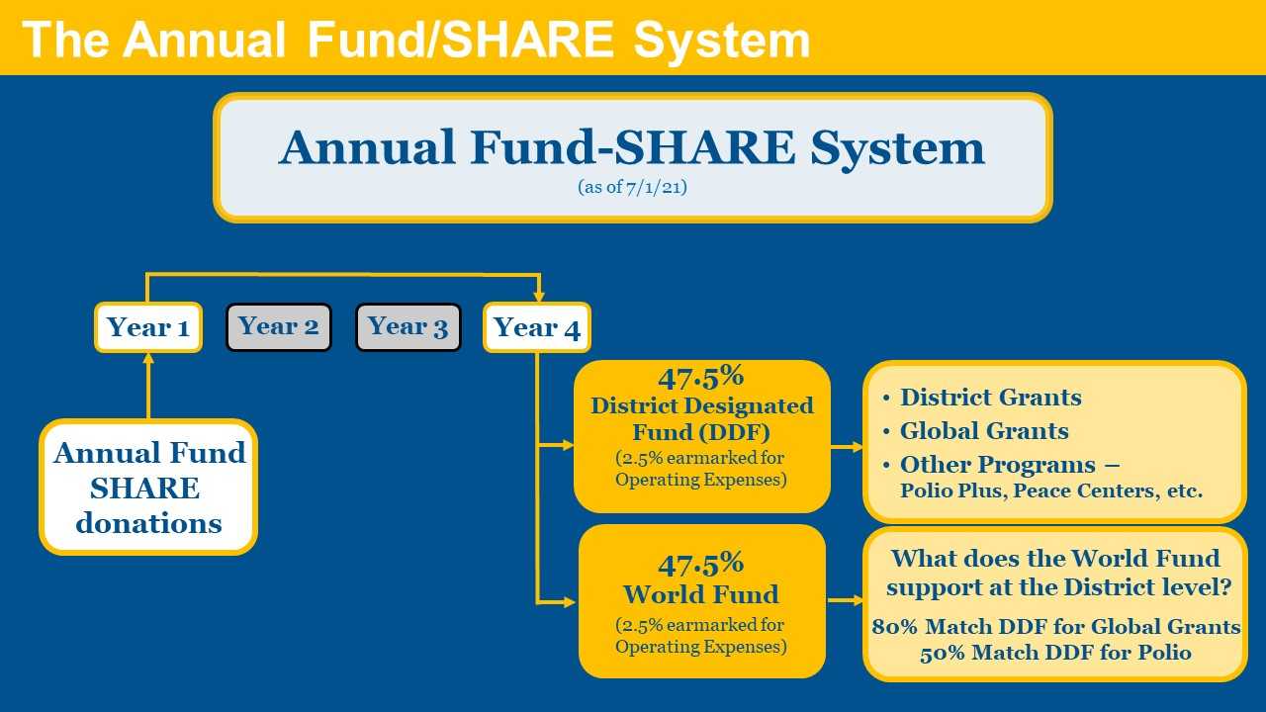
Grant Funding Model
Notes:
Refer to the funding model as illustrated on the slide. Highlight common themes or other insights from the debrief and lead the discussion including some or all of the following information.
The current grant model (two grant types) has simplified what type of grant should be used for a project
District grants are most flexible and are run by district leadership
Sustainability seeks practices that will make a project effective and be adopted by the community
Areas of Focus relate to the Mission of the Rotary Foundation
Rotarians impact global issues one problem at a time, but are made collective and measurable by the Areas of Focus
Changes were made to the Funding Model effective July 1, 2020.
Seven Areas of Focus (previously 6)
Global Grants no longer require a minimum of $15,000 come from the World Fund (TS-5 Rotary Foundation Funding Mode).
Cash is no longer matched by the World Fund. DDF (District Designated Funds) continue to be matched up to 100% by the World Fund.
SHARE is not an acronym; it is a method of spreading the impact of giving by the Rotarian to meet the priorities of the Rotary Foundation and to encourage maximum involvement and access by Rotarians worldwide.
Review the Grant Model process – How the money flows through as is illustrated on the slide. (refer to the Grant Model Explanation)
Rotary has a lot of partnership which have different meanings in different contexts through Rotary and the Rotary Foundation
Expertise
Community access and knowledge
Greater Impact
More effective and sustainable
Grant Model helps the club’s public image
Media attracted to big story with local involvement
Encourages members to participate and contribute to do good in the world
Grants provide an opportunity for global impact
Involved clubs attract and keep members
Inspired members are more likely to give and participate; members inspired by global impact

Slide 14

Notes:
Summarize the session
Now knowing some of what is available through the Rotary Foundation, use these tools, motivate your club, go to your district seminars, develop your Rotary contacts (including those you have made in RLI) and start “Doing Good In The World”
Point out that
All projects are local to somebody – the needs are local and real
A small project started today could develop into the next big project – even Polio Eradication began small
Rotarians have adopted a mission to help others
In a world filled daily with bad news of poverty, crime, and misfortune, we are a force for good in the world. We are making a difference. You are making a difference.

